Slide 1
Spring Semester 2026
Greek Literature in the Era of
the Atheno-Peloponnesian Wars (431–404 BCE)
Hecataeus of Miletus (I): Genealogies and Critical Stance
Prof. Dr. Ruobing Xian

Slide 2
Table of Contents
Testimonia on Hecataeus of Miletus
Hecataeus’ Voice
Hecataeus’ Genealogies and Critical Historiography

Slide 3
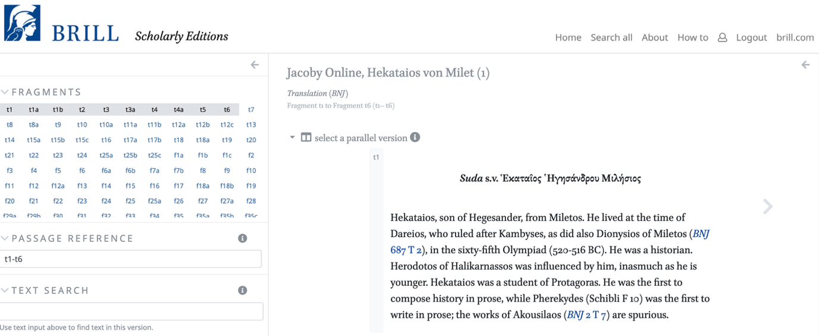
Hecataeus of Miletus (late sixth- and early fifth-century BCE intellectual)
https://scholarlyeditions.brillpublications.cn/bnjo/

Slide 4
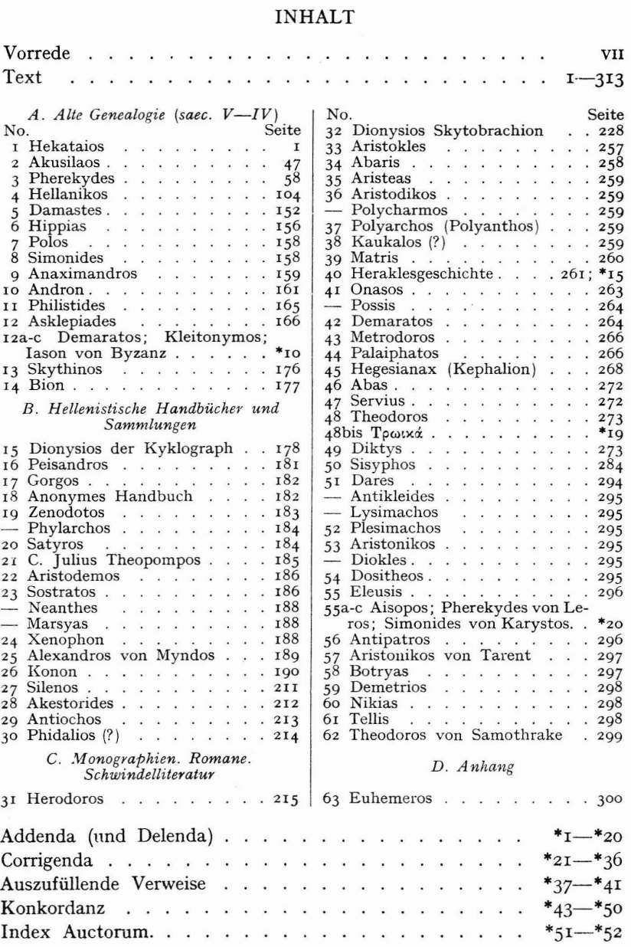
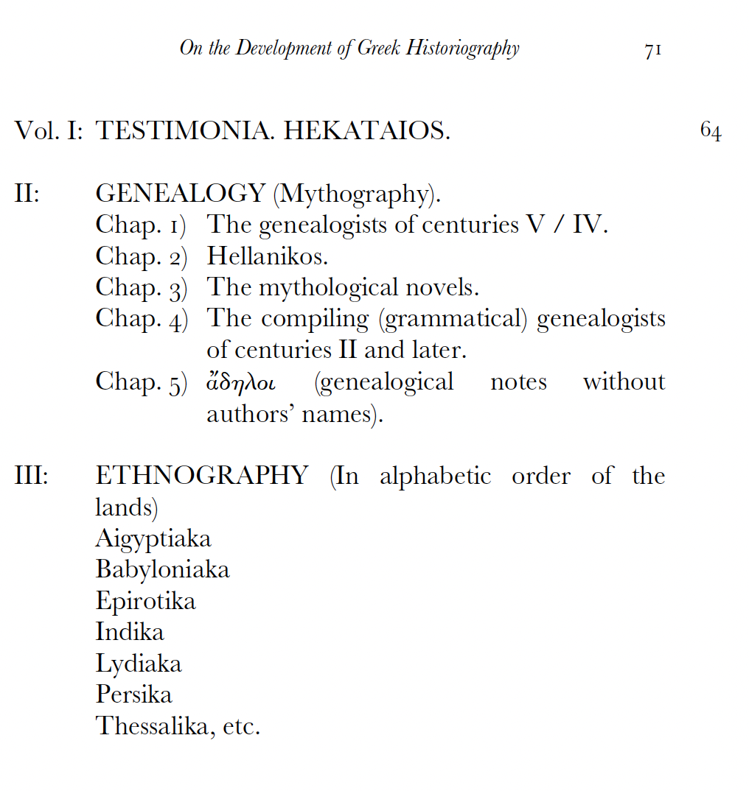
Hecataeus’ Works

Slide 5
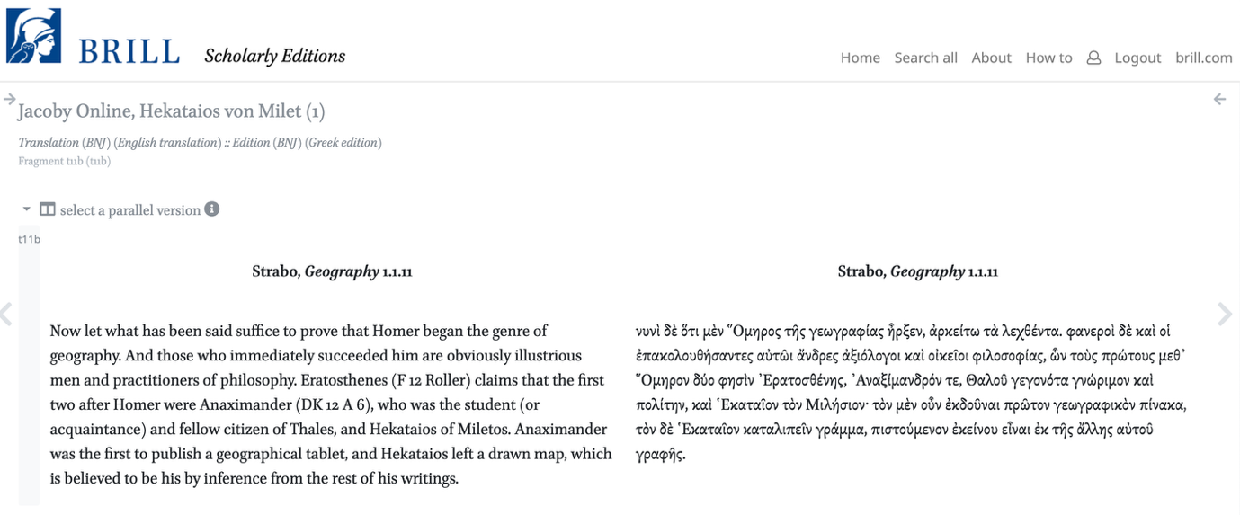
Hecataeus’ Relationship with the ‘Milesian School’?

Slide 6
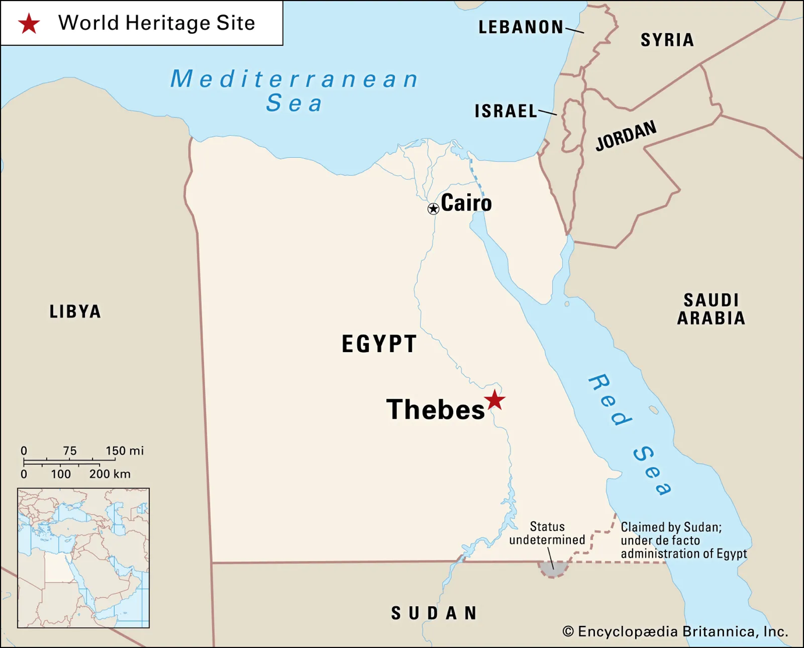
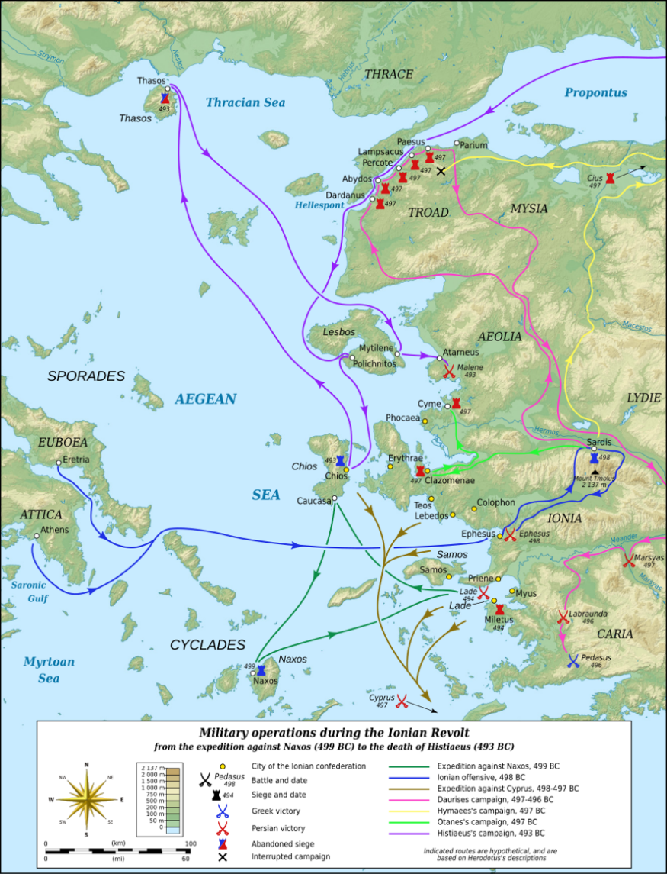
Herodotus’ Testimonia on Hecataeus

Slide 7
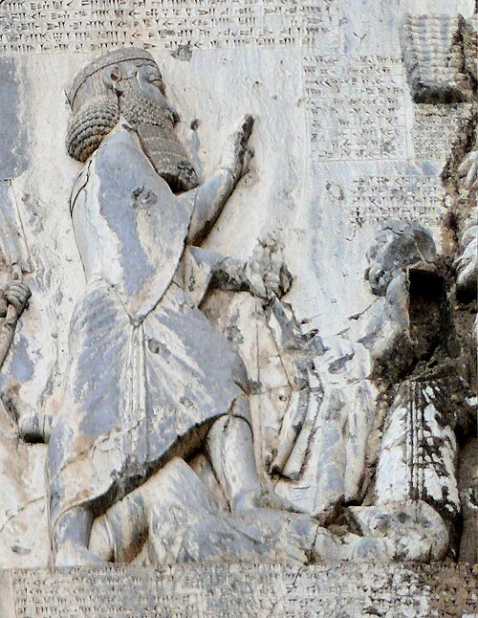
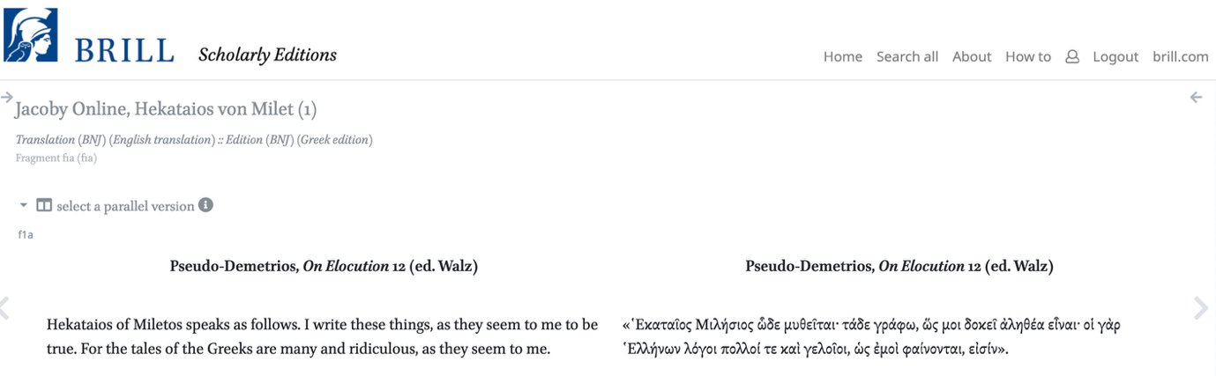
Hecataeus’ Voice

Slide 8

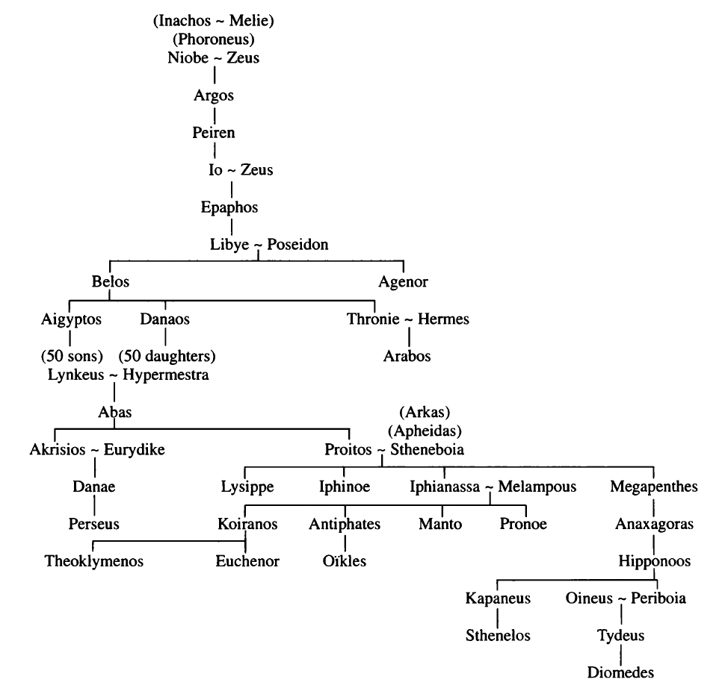
The Hesiodic Catalogue of Women

Slide 9

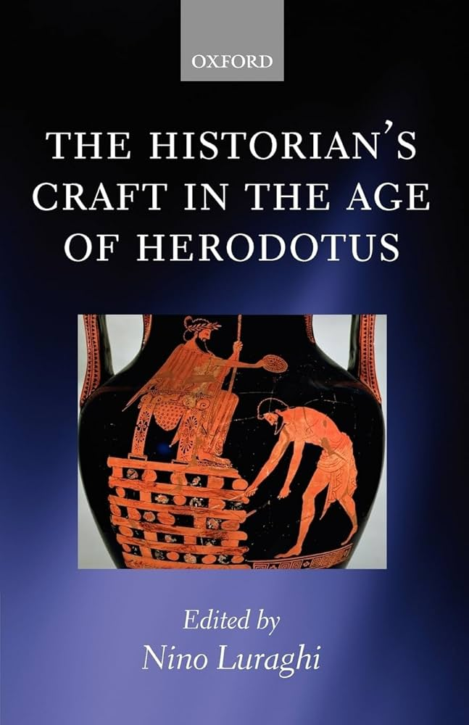
Hecataeus, the Iconoclast: From Genealogist to (Critical) Historiography?

Slide 10

Hecataeus and the Origin of Wine (F 15)

Slide 11
Thanks for your attention！
Contact: ruobingxian@fudan.edu.cn

